Slide 1
23-200-0105A BASIC MECHANICAL ENGINEERING

Slide 2
23-200-0105A BASIC MECHANICAL ENGINEERING
Course Outcomes:
On completion of this course, the student will be able to:
1. Summarise the role of mechanical engineering, different energy sources, and basic thermodynamic laws
2. Illustrate the principles and types of power generating and power producing devices
3. Explain the working of power transmission systems, electric and hybrid vehicles and modern fuel injection systems.
4. Demonstrate the types and classification of composite and smart materials and joining processes
5. Summarise the machine tools operations and advanced manufacturing systems
6. Explain the concepts of Mechatronics, Robotics, and Automation in IoT

Slide 3
Module 3
Introduction to engineering materials: composite and smart materials.
Joining Processes: Soldering, Brazing and Welding, Definitions, classification of welding process, Arc welding, Gas welding and types of flames.
Machine Tool Operations: Working Principle of lathe, Lathe operations: Turning, facing, knurling. Working principles of Drilling Machine, drilling operations: drilling, boring, reaming. Working of Milling Machine, Milling operations: plane milling and slot milling.
Introduction to Advanced Manufacturing Systems: Introduction, components of CNC, advantages and applications of CNC, 3D printing.

Slide 4
Module 4
Introduction to Mechatronics and Robotics: open-loop and closed-loop mechatronic systems. Classification
based on robotics configuration: polar cylindrical, Cartesian coordinate and spherical. Application, Advantages and disadvantages.
Automation in industry: Definition, types – Fixed, programmable and flexible automation, basic elements with block diagrams, advantages.
Introduction to IOT: Definition and Characteristics, Physical design, protocols, Logical design of IoT, Functional blocks, and communication models.

Slide 5
Mechanical engineering is a branch of engineering science that deals with the design and development of work producing and work absorbing machines.

Slide 6
MANUFACTURING PROCESSES
Module 3

Slide 7
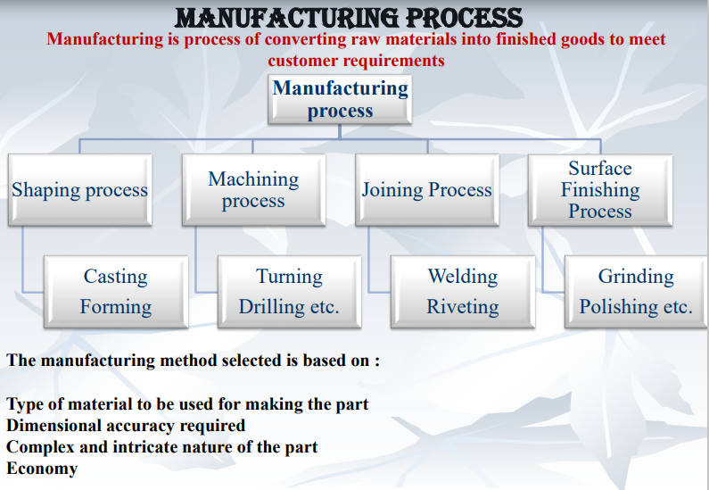

Slide 8
WELDING
Is defined as –
Welding is a process of making a permanent joint by establishing inter atomic bonds between two or more pieces of metal by using heat or heat and pressure.

Slide 9
Most essential requirement is heat.
Pressure may or may not be used.
Filler material may or may not be used.
Flux is used to resist oxidation and to remove impurities.
Thus, “Welding is the process of joining similar or dissimilar metals by the application of heat, with or without the application of pressure and addition of filler material”.

Slide 10
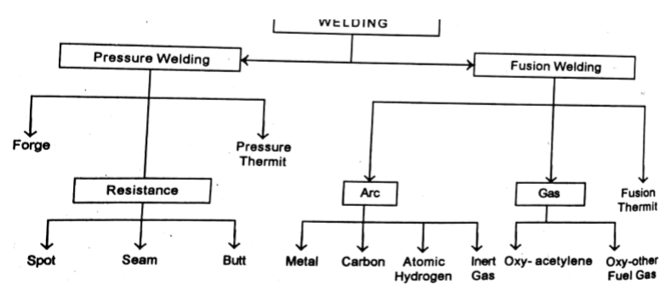
Classification Of Welding

Slide 11
Classification Of Welding
Welding of metals can be divided into two categories.
1. Plastic Welding (Pressure welding)
2. Fusion (Diffusion) Welding.
Plastic Welding -In this type of welding the metals to be joined are to be heated to the plastic state and then forced together by external pressure without the addition of filler material. Eg. Forge Welding, resistance welding.

Slide 12
Fusion Welding
In this type of welding no pressure is involved but a very high temperature is produced in or near the joint.
The metal at the joint is heated to the molten state and a joint is formed as a result of solidification.
The heat may be generated by electric arc, combustion of gases or chemical action. A filler material may be used during the welding process

Slide 13
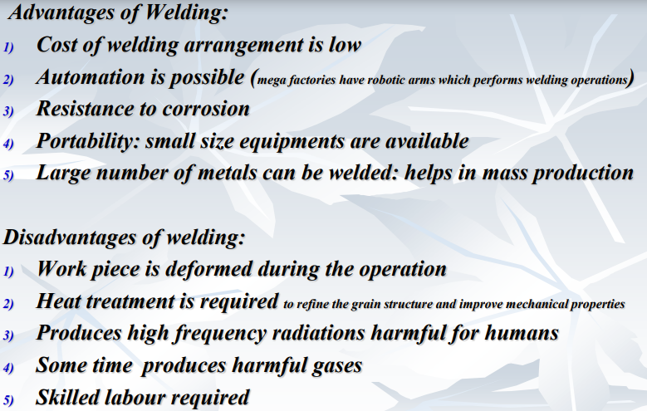

Slide 14
APPLICATIONS
Aircraft construction
Automobile Construction (chassis, body, structure, doors)
Bridges
Railways (tracks, coaches/wagons).
Buildings
Pressure vessels and tanks
Piping and Pipelines
Ships
Machine tool
Household
Heavy machineries

Slide 15
GAS WELDING
Gas Welding is a Fusion-Welding process.
It joins metals using the heat of combustion of some fuel gas (acetylene, hydrogen, natural gas) in air or oxygen.
Temperature produced ranges from 3000°C to 3400 °C
The intense heat produced melts and fuses together the edges of parts to be welded, generally with the addition of filler material.
It is used for welding ferrous and non ferrous metals particularly for thin sections up to 6 mm thick.

Slide 16
Types of Gas Welding
Oxy-Acetylene Welding
Air-Acetylene Welding
Oxy-Hydrogen Welding

Slide 17
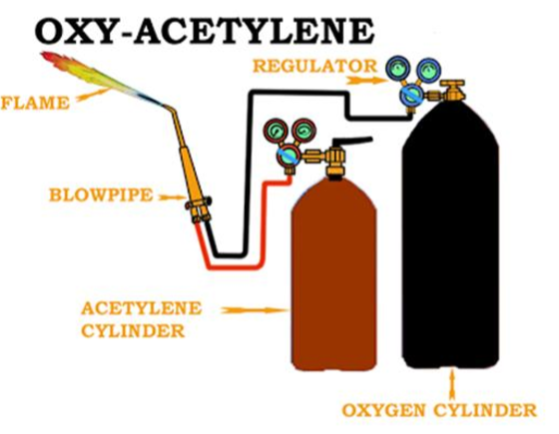
Oxy-acetylene Welding Equipment

Slide 18
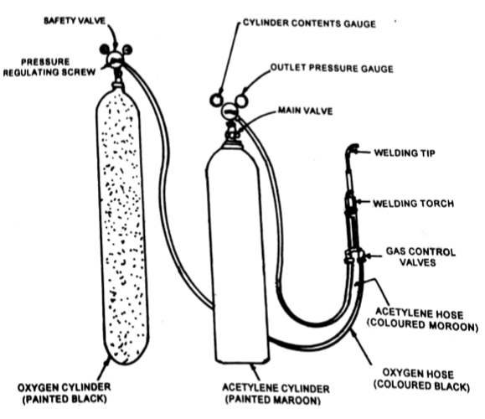
Oxy-acetylene Welding Equipment

Slide 19
Oxy-acetylene Welding Equipment
Acetylene Cylinder - Used for storing Acetylene
Oxygen Cylinder -Used for storing Oxygen
Oxygen and Acetylene pressure Regulators -The pressure of the gases obtained from the cylinders is considerably higher than the gas pressure required to carry out the welding operation.
The purpose of regulators is to
-reduce the pressures of gases
- to produce steady flow of gases.

Slide 20
Oxy-acetylene Welding Equipment
Filler Rods - Used as Filler Metal
Flux -Used for removing impurities and oxides.
Welding Torch or Blow Pipe -Oxygen and the fuel gas are mixed in the welding torch. Welding Torch controls the flow of gases to the welding nozzle.

Slide 21
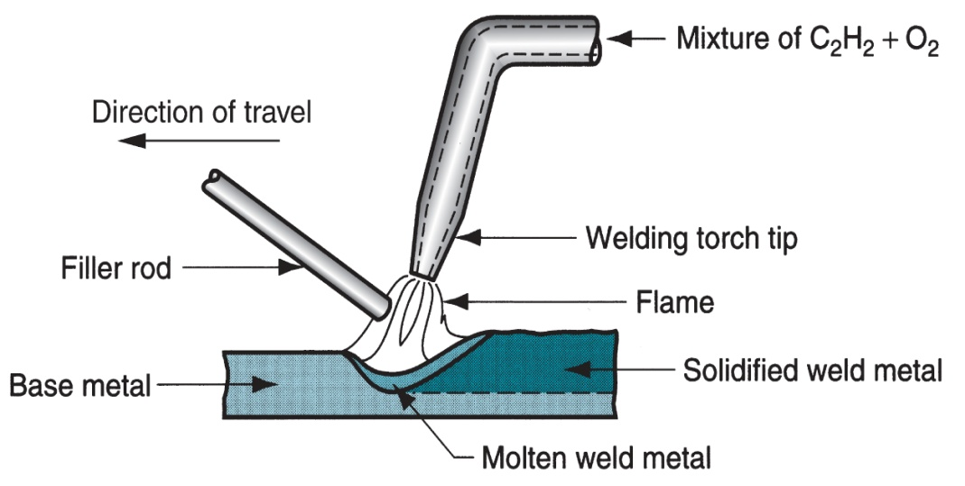
Oxy-Acetylene Welding

Slide 22
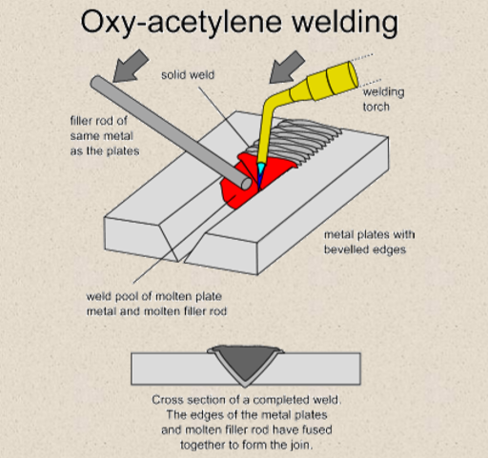

Slide 23
Types of Flame in Oxy Acetylene Gas Welding
• Neutral flame
• Oxidizing flame
• Carburizing (Reducing) flame

Slide 24
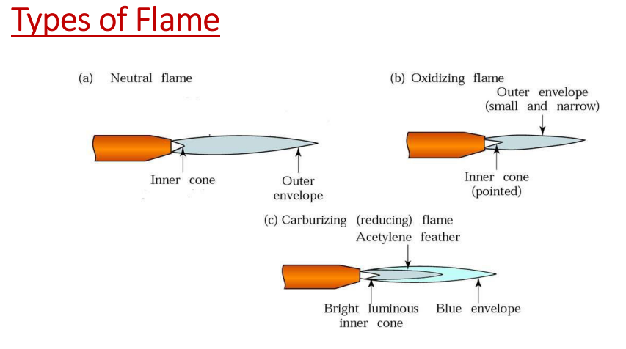

Slide 25
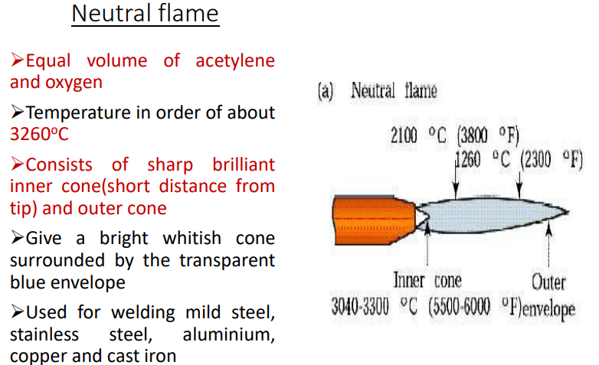

Slide 26
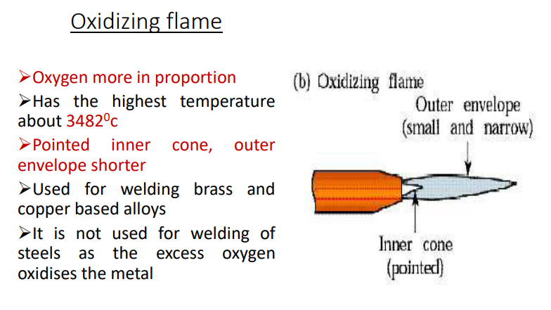

Slide 27
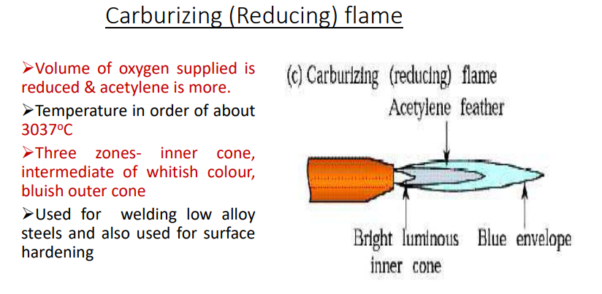

Slide 28
Advantages Of Gas Welding
Oxy-Fuel gas can be easily controlled.
Suitable for thin sheets.
Equipment is portable.
It can weld most common materials.
By changing the nozzle the torch can be use for heating, and cutting purposes.
Cost is low.

Slide 29
Disadvantages of Gas Welding
Heavy sections cannot be joined.
Flame temperature is less than that of arc.
Fluxes used produce fumes that are irritating to eyes, nose and lungs.
Slower than arc welding Process.
Distortion to the work piece is more compared to arc welding process.
Careful handling and storing is required.

Slide 30
ARC WELDING
Method of fusion welding in which the metals at the joint is heated to molten state by an electric arc.
Arc column is generated between an anode(electrode) and the cathode(metal to be joined)
Temperature of the arc is about 6000⁰C to 7000⁰C

Slide 31
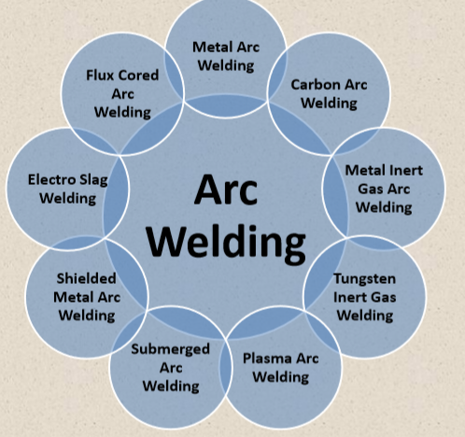

Slide 32
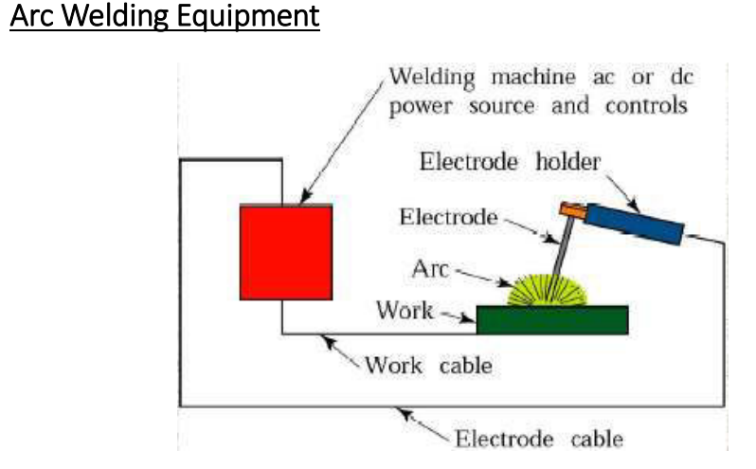

Slide 33
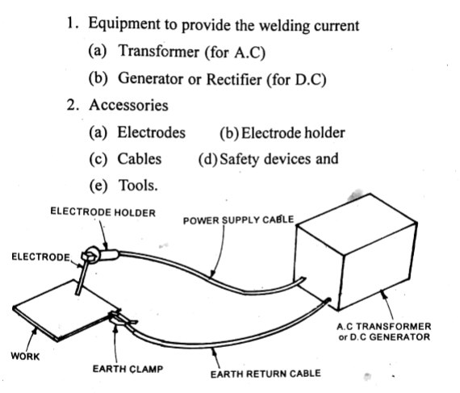
ARC WELDING EQUIPMENT…

Slide 34
ELECTRODES
Non- consumable electrodes: May be made of carbon, tungsten or graphite which do not consume during welding operation.
Consumable electrodes:
It is consumed during welding operation. May be made of various metals depending upon the purpose and chemical composition of the metals to be welded.
electrode may be bare(uncoated) or flux coated
ex.steel

Slide 35
ARC WELDING- MANUAL METAL ARC WELDING
The heat is generated by an electric arc between base metal and a consumable electrode.
In this process electrode movement is manually controlled hence it is termed as manual metal arc welding
In shielded metal arc welding, the protection to the weld pool is provided by covering of
slag formed over the surface of weld pool/metal and
b) inactive gases generated through thermal decomposition of flux/coating materials on the electrode

Slide 36
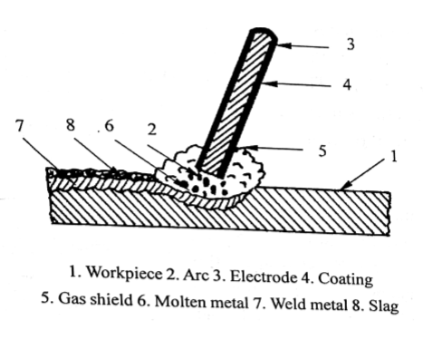
ARC WELDING

Slide 37
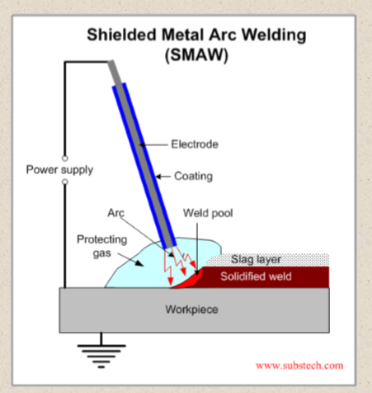

Slide 38
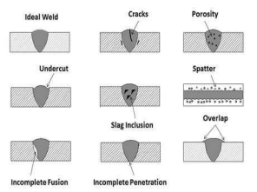
WELDING DEFECTS
Weld crack
Porosity
Undercut
Spatter
Slag inclusion
Poor fusion
Wraping and distortion
Lack of penetration

Slide 39
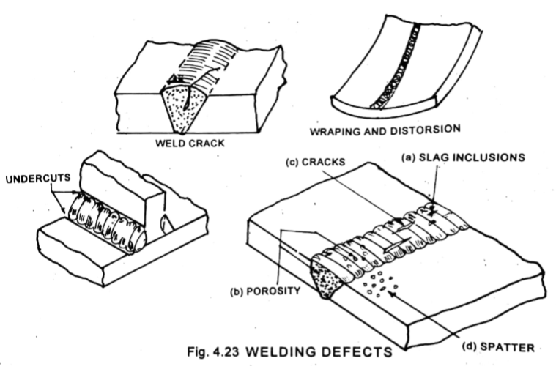
WELDING DEFECTS..

Slide 40
SOLDERING
Soldering is a process in which two or more items are joined together by melting and putting a filler metal (Solder: Lead-tin alloy) into the joint.
The melting temperature of filler metal is lower than 450°C and also lower than the melting point of the components to be joined.
Unlike welding, soldering does not involve melting the work pieces.
Solder is melted by using a soldering iron, which is heated by electrical resistance.
The filler metal flows into the gap between close-fitting parts by capillary action.

Slide 41
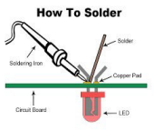
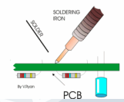
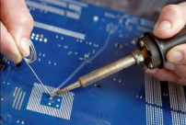

Slide 42
TYPES
Soft soldering – generally used in sheet metal work for joining parts which are not subjected to high load or high temperature. The melting point of solder using ranges from 150 to 300 °C
Hard soldering – stronger than soft soldering. Silver alloy with tin is used as hard solder , the melting point of which is 300 to 600 °C

Slide 43
Applications
It is mainly used in electronics industry -Electronic boards and similar small parts which are not subjected to load and temperature.
Copper, silver and gold are easy to solder
Electronics manufacture, implantable devices, medical devices, connectors etc.

Slide 44
BRAZING
• Brazing is a metal joining process in which two or more metal items are joined together by melting and flowing a filler metal (spelter : copper-zinc alloy) into the joint.
The filler metal flows into the gap between close-fitting parts by capillary action. Cool it and solidify it.
• Melting temperature of filler metal is more than 450°C but lower than the melting temperature of the components to be joined.
Brazing differs from welding in that it does not involve melting the work pieces.
Brazing gives a much stronger joint compared to soldering

Slide 45
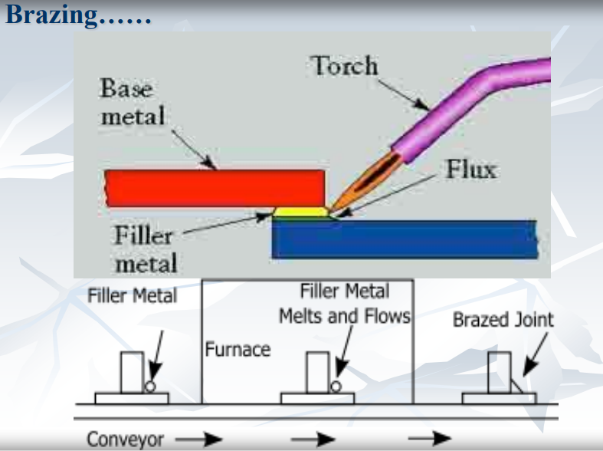
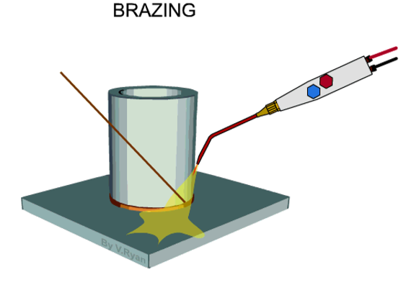

Slide 46
TYPES
TORCH BRAZING
FURNACE BRAZING
RESISTANCE BRAZING
INDUCTIVE BRAZING
APPLICATIONS -
Fastening of pipe fittings,
radiators,
heat exchangers,
electrical parts,
Water supply,
Fuel gas distribution,
Medical gas,
Air conditioning and refrigeration,
Fire protection

Slide 47
